Slide 1
SUMMARY
This visualization seeks to investigate the borrowers with the highest median income based on their occupation. And to find what category, homeowners or non homeowners, defaulted the most in paying back their loans.
Here is the link to the Initial visualization.
You will find the final visualization here.

Slide 2
Design
Initially, I used a column chart for all the visualization but after collecting feedback from reviewers, I made changes as suggested and added one more chart. I also changed some of the charts to line plot to best reflect or show the change in number of loans over a given period of time.
Categorical variables such as the status of a loan were encoded using colors and added to the plot as highlighters and/or filters.

Slide 3
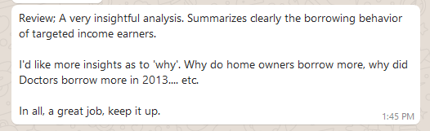
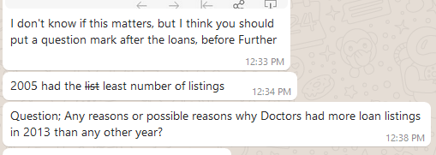
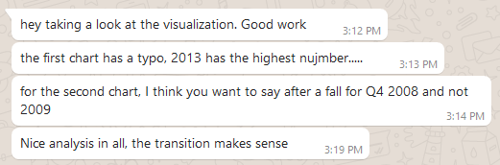

Feedbacks

Slide 4
Resources
Average Income in the USA by Family and Household – The Balance (Date accessed: 3/16/2019)
Link to data: https://s3.amazonaws.com/udacity-hosted-downloads/ud651/prosperLoanData.csv

